Slide 1

Rotational Motion
Exploring the Spin of the Universe

Slide 2






Akhlak
Hossain
2022-3-60-057
Meet The Team:
Tasnia Tabassum Azra
2022-3-60-084
Tasmia Sohel
2022-3-60-097

Slide 3


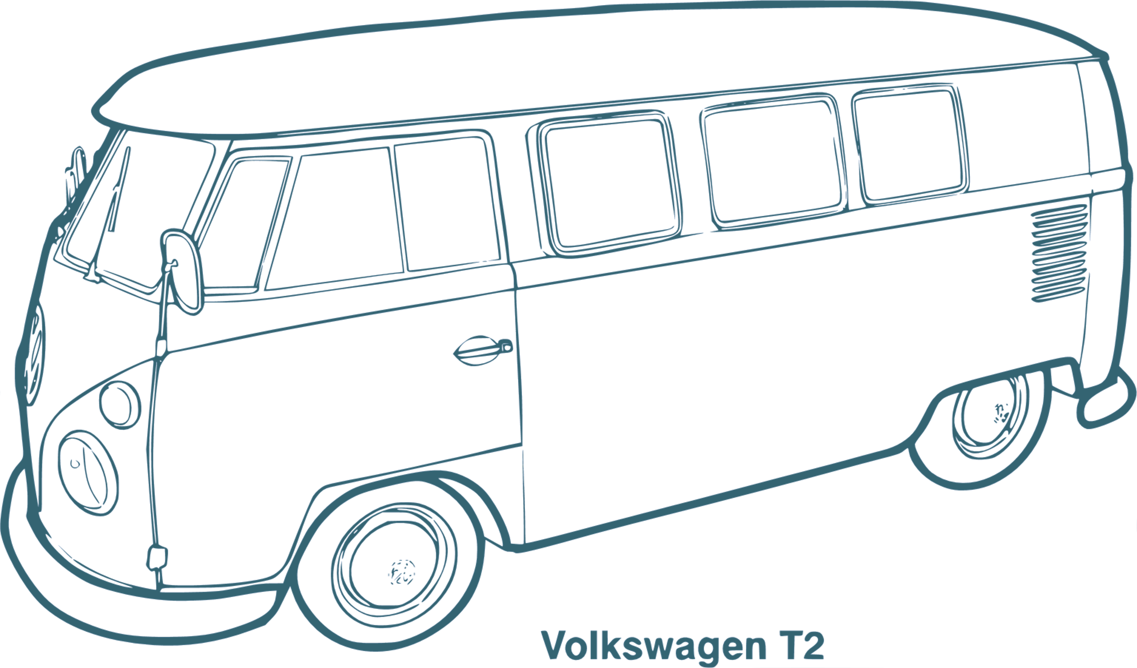
What is Rotational Motion?

Slide 4

How does Rotational Motion Work?

Slide 5
Why is it necessary for us to study about Rotational Motion?

Slide 6
Advantages of Understanding Rotational Motion:

Slide 7

Energy Sector:

Slide 8
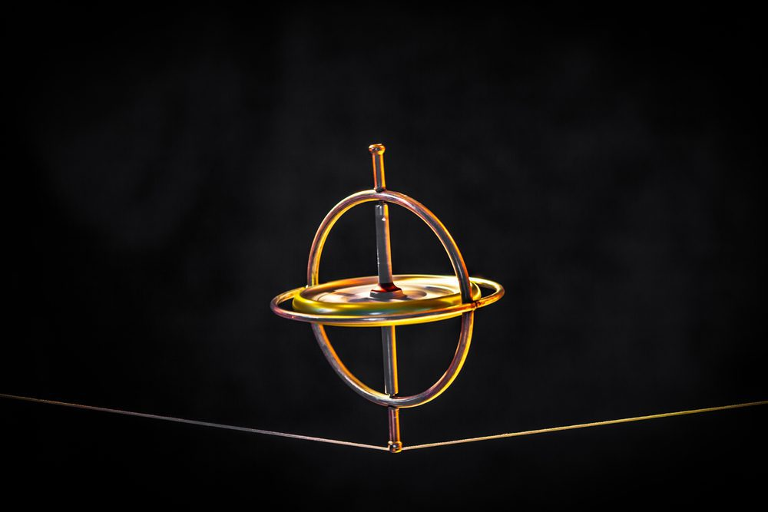
Stability:

Slide 9
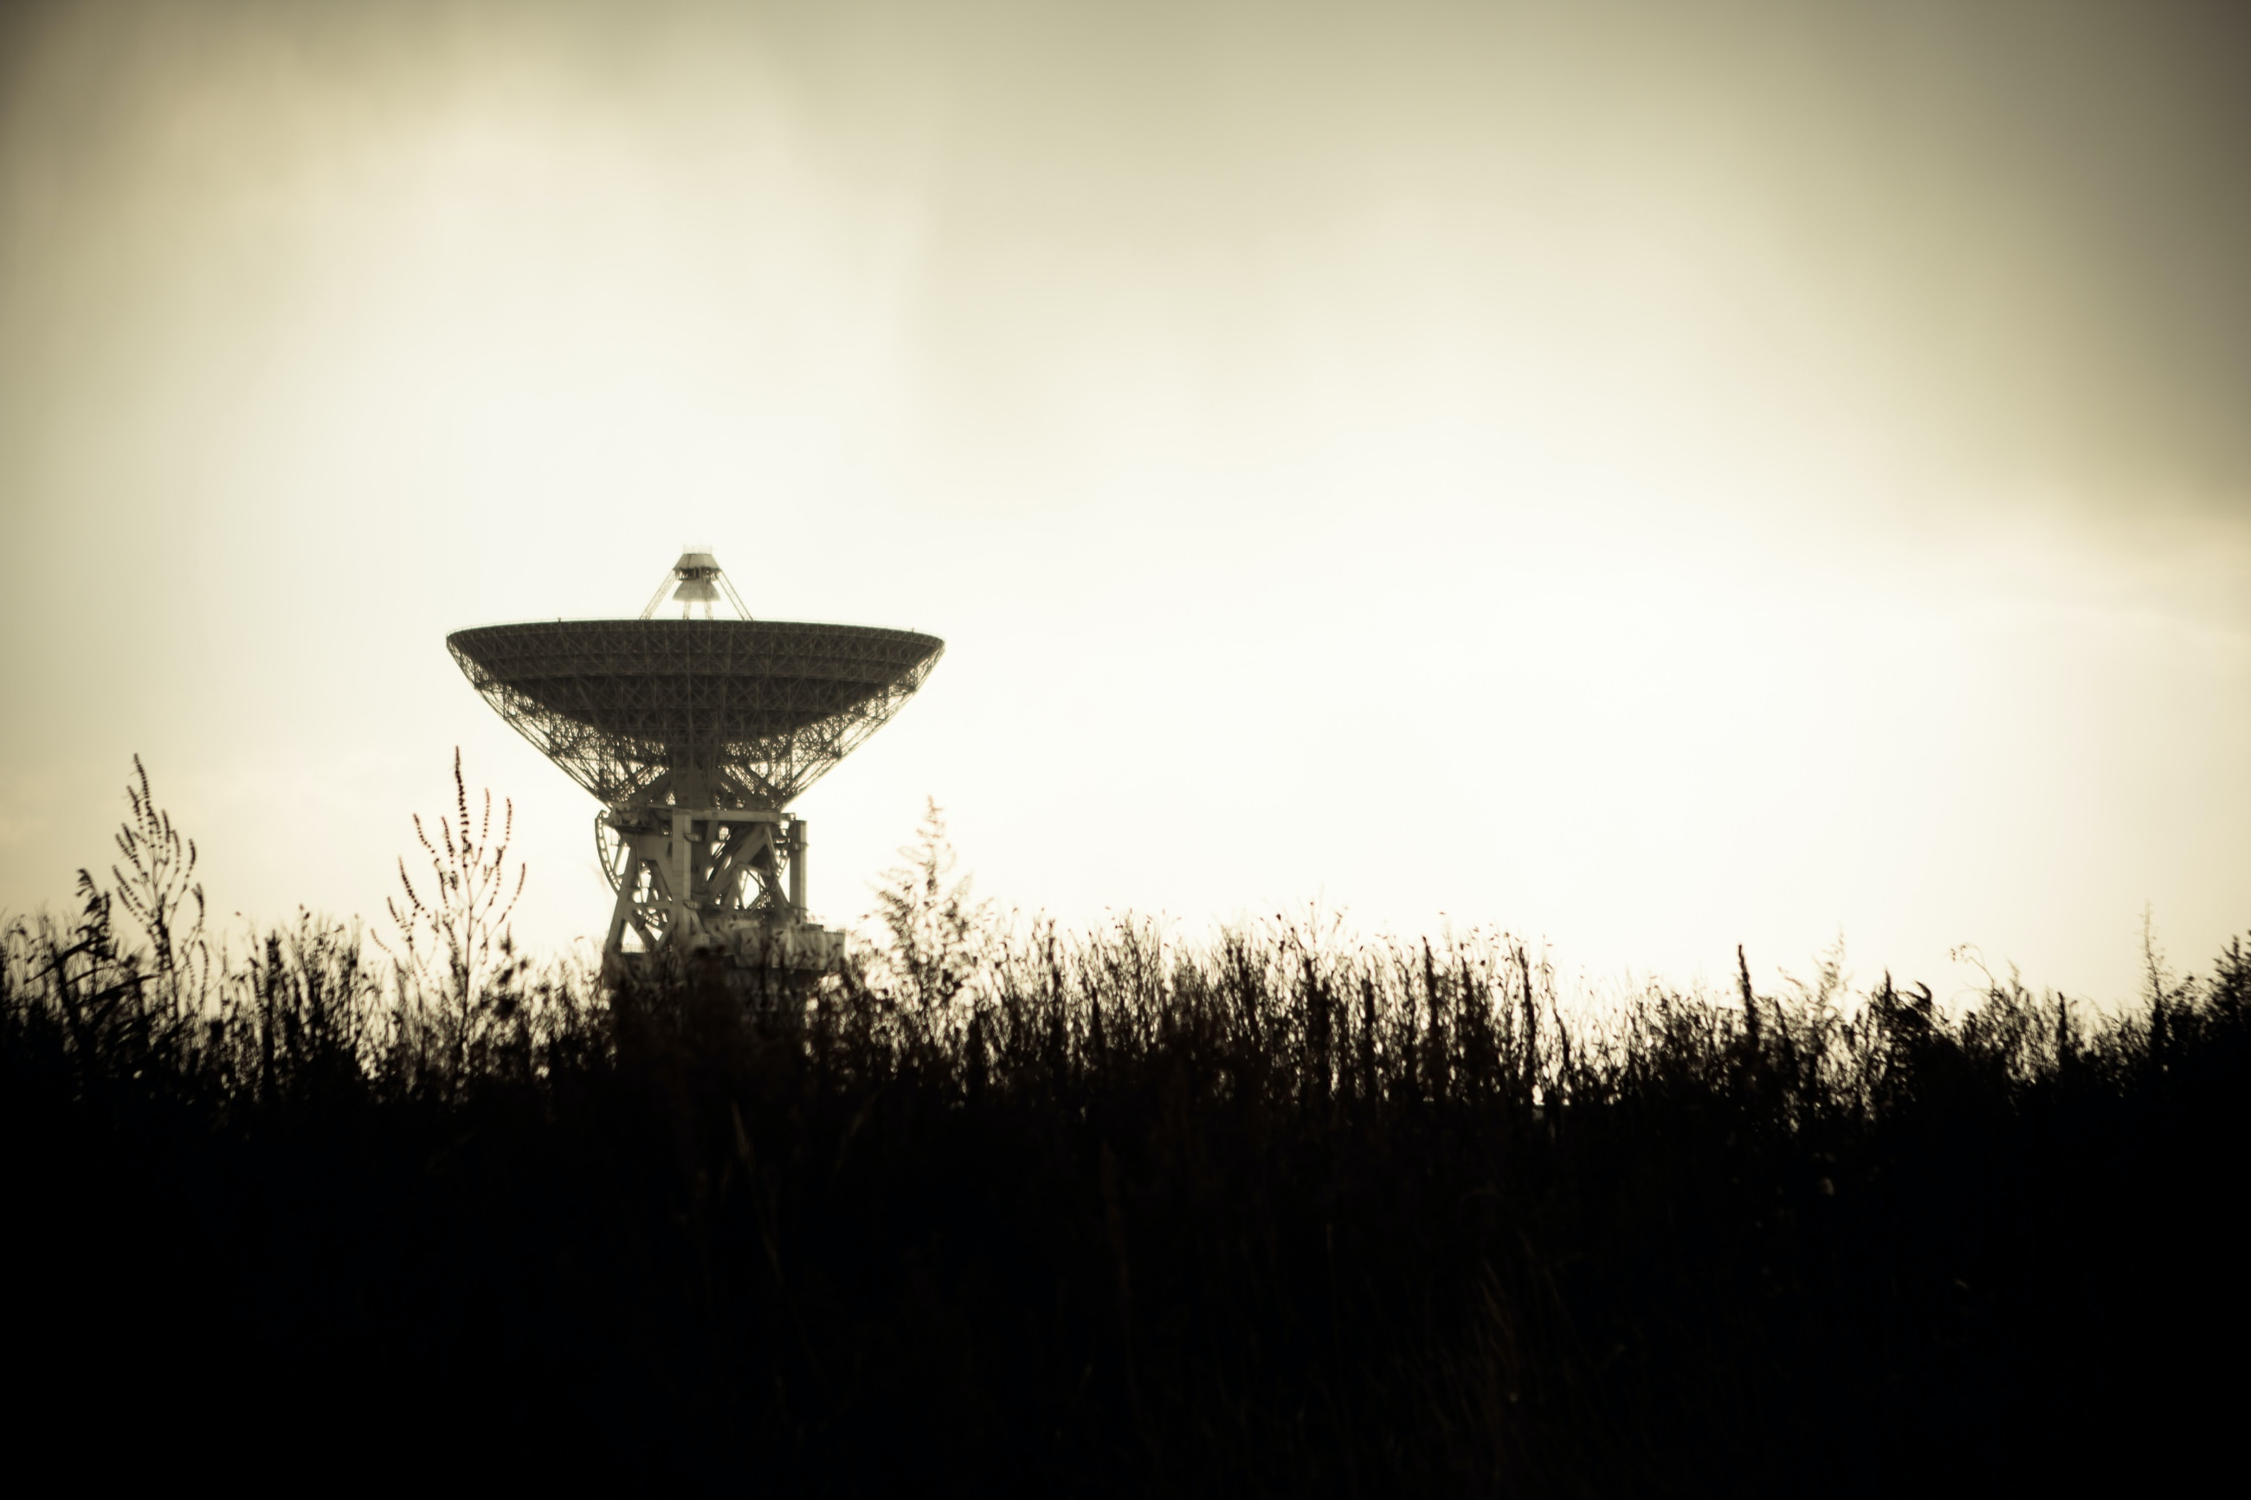
Space Exploration:

Slide 10
Disadvantages of
Rotational Motion:

Slide 11
Mechanical Wear & Dynamic Imbalance:

Slide 12

Dynamic Imbalance:

Slide 13
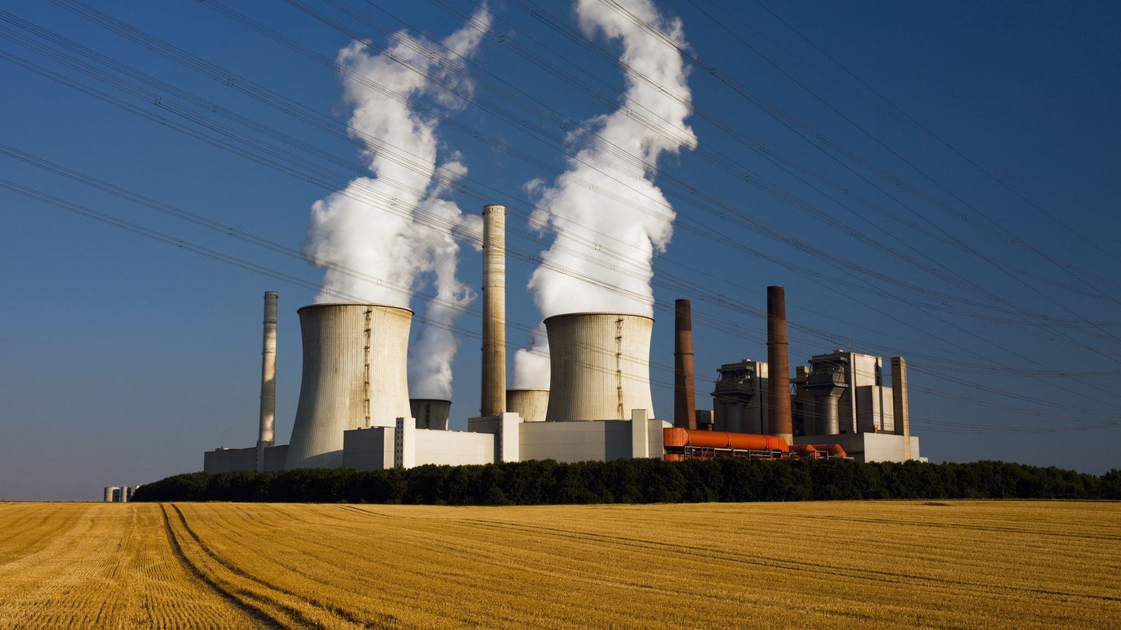
Energy Loss:

Slide 14
Practical Uses of
Rotational Motion

Slide 15

Transportation:

Slide 16



Everyday Technologies:

Slide 17
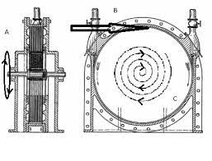
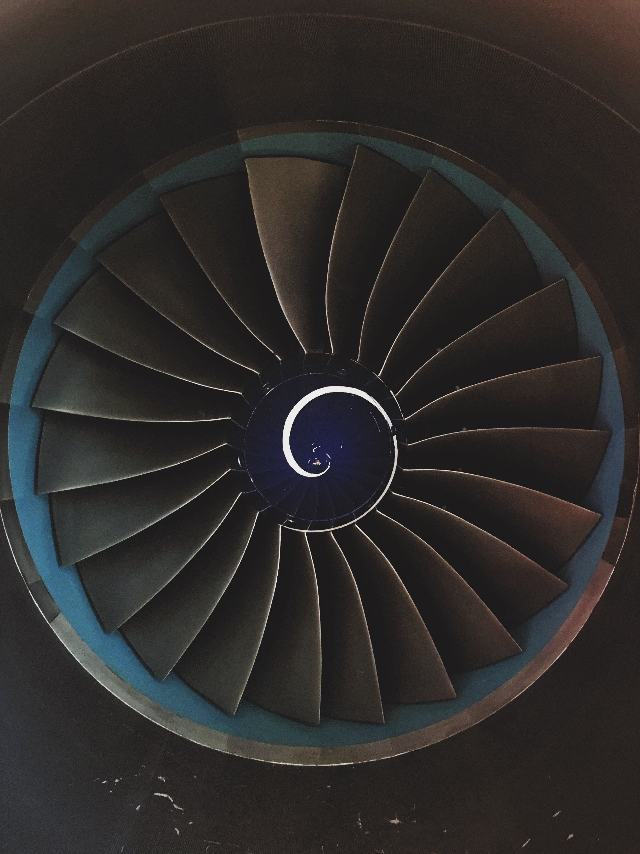
Turbines:

Slide 18
Research Scopes in Rotational Motion

Slide 19

Quantum Mechanics:

Slide 20
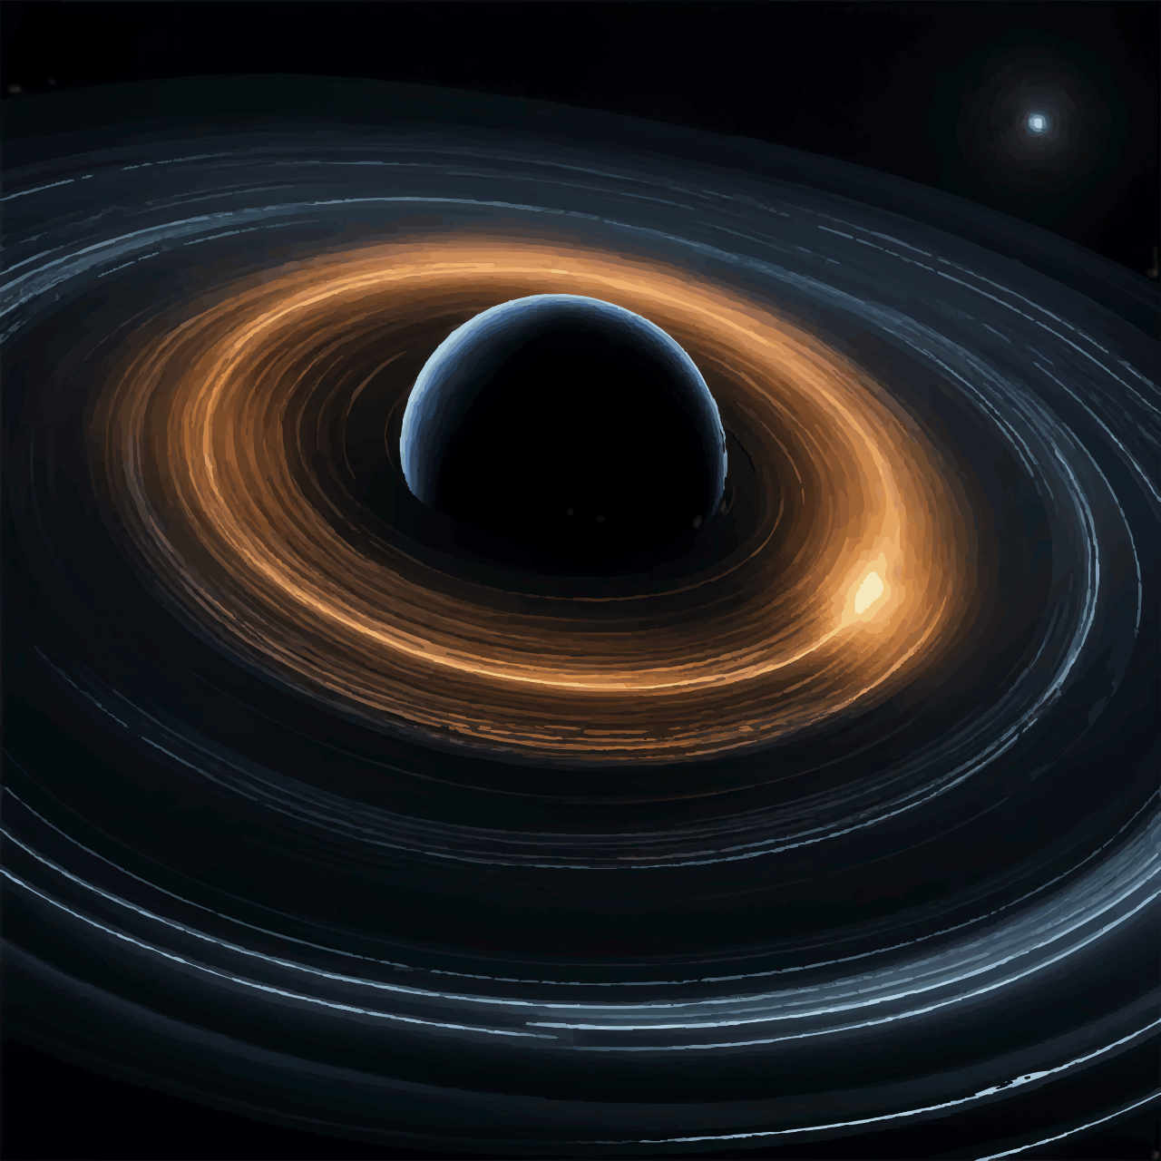
Studying Astrophysics:

Slide 21
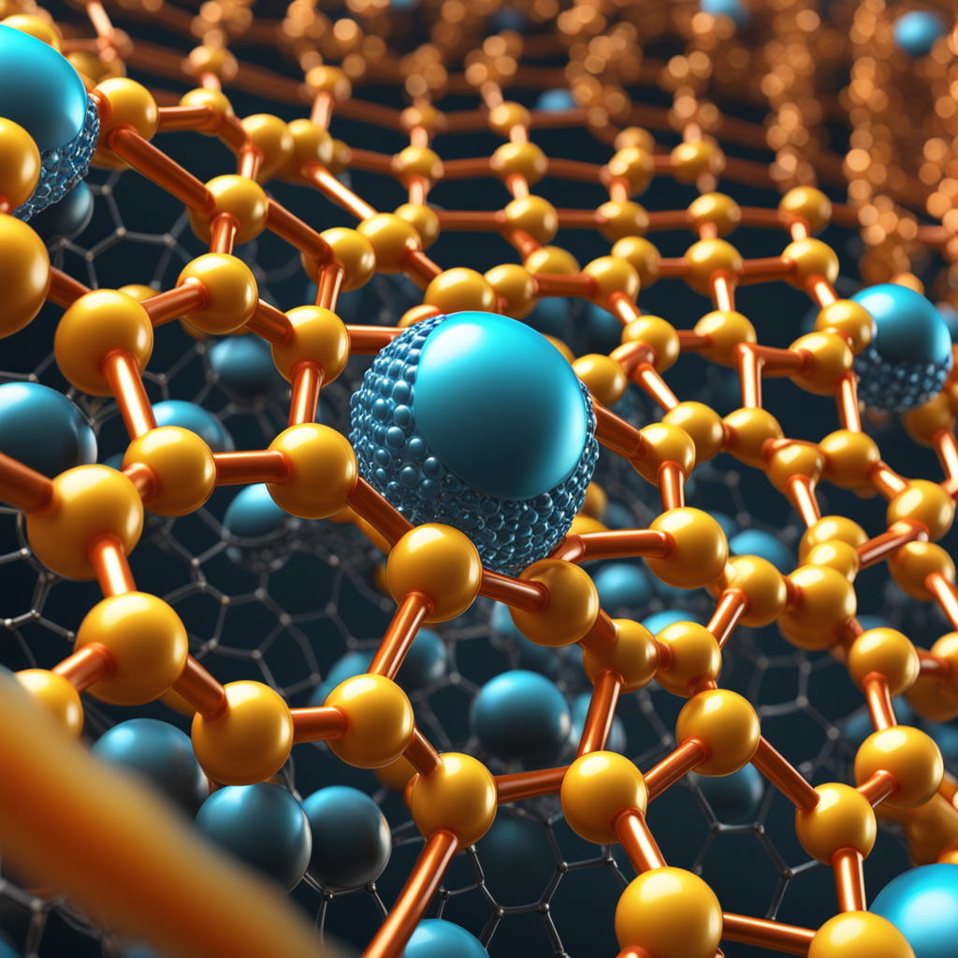
Materials Physics:

Slide 22
Conclusion

Slide 23
Thanks
It's been our pleasure to present.

